Slide 1

Deadlocks Chapter 8
Description of Deadlocks
Methods of Preventing or
Avoiding Deadlocks
Detection and Recovery from Deadlocks

Slide 2
Deadlock Avoidance
Deadlock prevention algorithms result in low device utilization and reduced system throughput
Avoid deadlock by requiring additional information about how resources are to be requested
For every request made, system can decide whether or not a thread should wait in order to avoid a possible future deadlock
For a request, the system considers
The resources currently available
The resources currently allocated to each thread
The future requests and releases of each thread

Slide 3
Deadlock Avoidance
Simplest model requirement
Each thread declare the maximum number of resources of each type that it may need
A deadlock avoidance algorithm dynamically examines the resource-allocation state to ensure that a circular wait state can never exist
Resource allocation state is defined by
The number of allocated and available resources
The maximum demands of the threads
Safe State
A system is in a safe state only if there exists a safe sequence
A sequence of threads <T1, T2, …, Tn> is a safe sequence for the current allocation state

Slide 4
Deadlock Avoidance
If for each Ti, the resource requests that Ti can make can be satisfied by the currently available resources and resources held by all Tj with j<i
If no safe sequence exists, system is unsafe
A safe state is not a deadlocked state
An unsafe state may lead to a deadlock
The behavior of threads controls unsafe state
An example with three threads
Safe and unsafe states
An avoidance algorithm can be developed to allocate resources only if it leaves the system in a safe state
If a thread requests a resource that is currently available, it may still have to wait

Slide 5
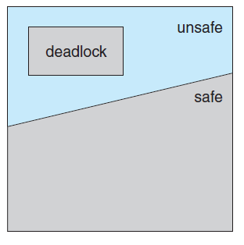
Safe, Unsafe and Deadlocked State
Notes:
5

Slide 6
An Example System
Maximum needs Need Current Allocation
T0 10 5 5 available = 2
T1 4 2 2 +2=4
T2 9 6 2
System has 12 drives
System is currently safe and the sequence is
<T1, T0, T2>
At time t1, T2 requests a drive and is allocated
The system goes into an unsafe state

Slide 7
Resource-Allocation-Graph Algorithm
If there is only one instance of each resource in a system, a variant of resource-allocation graph can be used for deadlock avoidance
Claim edge is added to this graph in addition to request and assignment edge
A claim edge Ti → Rj indicates that thread Ti may request resource Rj at some time in future
Represented in the graph by a dashed line
When the resource is requested, claim edge is converted into request edge
Resources must be claimed a priori
A requested resource is granted to a thread only if by converting the request edge to an assignment edge does not result in formation of a cycle in the resource-allocation-graph

Slide 8
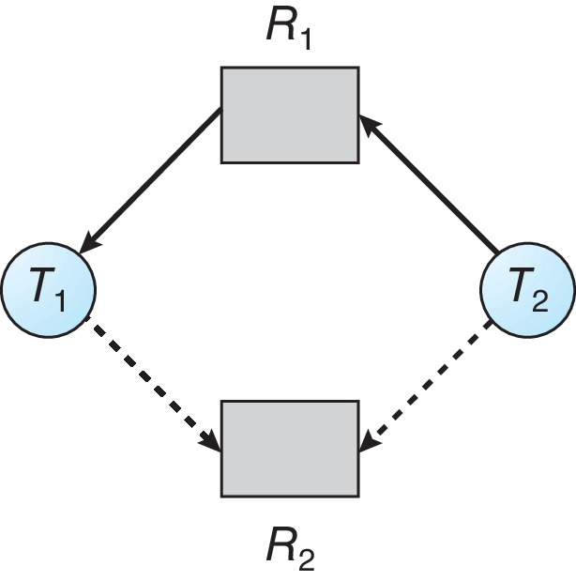
Resource-Allocation Graph
Notes:
8

Slide 9
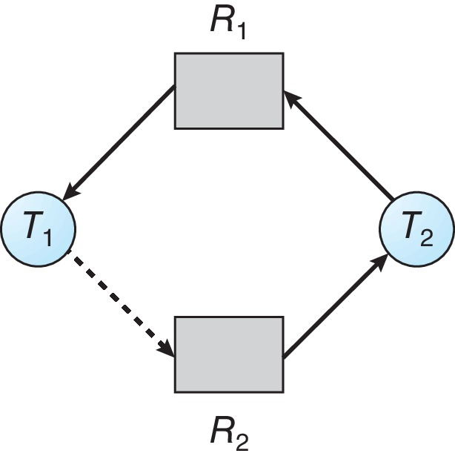
Unsafe State In Resource-Allocation Graph
Notes:
9

Slide 10
Banker’s Algorithm
This algorithms overcomes the limitation of graph-allocation algorithm
Applicable to systems having any number of instances of various resources
A new thread entering the system declares it total resource needs
When a request is made, the system ensures that the allocation would not leave the system in an unsafe state
If it does, the thread is made to wait until some other thread releases its resources
Several data structures need to be maintained to implement the algorithm
Let n be the number of threads in the system and let m be the number of resource types

Slide 11
Banker’s Algorithm
Available
A vector of length m that indicates the number of available resources of each type
Max
An n x m matrix that defines the maximum demand of each thread
Allocation
An n x m matrix that defines the maximum number of resources of each type currently allocated to each thread
Need
An n x m matrix that indicates the remaining resource need of each thread
The data structures vary over time in both size and value

Slide 12
Banker’s Algorithm
Each row in matrices Allocation and Need are treated as vectors referred to as Allocation_{i} and Need_{i}
Some notations
If X and Y are vectors of length n, then
X ≤ Y, iff X[i] ≤ Y[i] for all i = 1,2,…,n
Also, Y < X if Y ≤ X and Y ≠ X
Safety Algorithm
The safety algorithm is described as follows
Let Work and Finish be vectors of length m and n respectively
Initialize Work = Available
Finish [i] = false for i = 0,1,2,…,n-1

Slide 13
Banker’s Algorithm
Find an index i such that both
Finish [i] == false
Need_{i} ≤ Work
If no such i exists, go to Step 4
Work = Work + Allocation
Finish [i] = true
Go to step 2
If Finish [i] == true for all i
The system is in a safe state

Slide 14
Banker’s Algorithm
Resource-Request Algorithm
Determine whether requests can be safely granted
Let Request_{i} be the request vector for thread Ti
If Request_{i} [j] == k, then Ti wants k instances of Rj
On a request by Ti
If Request_{i} ≤ Need_{i}, go to step 2
else raise an error condition
If Request_{i} ≤ Available, go to step 3
else Ti must wait as resources are not available

Slide 15
Banker’s Algorithm
Available = Available - Request_{i};
Allocation_{i} = Allocation_{i} + Request_{i};
Need_{i} = Need_{i} - Request_{i};
If the resulting resource-allocation state is safe, transaction is completed
Ti is allocated resources
If the new state is unsafe, Ti must wait
Example Allocation Max Available
A B C A B C A B C
T₀ 0 1 0 7 5 3 3 3 2
T₁ 2 0 0 3 2 2
T₂ 3 0 2 9 0 2 Snapshot of
T₃ 2 1 1 2 2 2 current state
T₄ 0 0 2 4 3 3

Slide 16
Example of Banker’s Algorithm
Need
A B C
T₀ 7 4 3
T₁ 1 2 2
T₂ 6 0 0
T₃ 0 1 1
T₄ 4 3 1
The system is in a safe state since the sequence
< T₁, T₃, T₄, T₂, T₀> satisfies safety criteria
Notes:
16

Slide 17
Example: T₁ Request (1,0,2)
Check that Request ≤ Available -
that is, (1,0,2) ≤ (3,3,2)
Allocation Need Available
A B C A B C A B C
T₀ 0 1 0 7 4 3 2 3 0
T₁ 3 0 2 0 2 0
T₂ 3 0 2 6 0 0
T₃ 2 1 1 0 1 1
T₄ 0 0 2 4 3 1
Executing safety algorithm shows that sequence
< T₁, T₃, T₄, T₀, T₂> satisfies safety requirement
Can request for (3,3,0) by T₄ be granted?
Request by T0 of (0,2,0)?
Notes:
17

Slide 18
Deadlock Detection
If prevention and avoidance algorithms are not used, deadlock may occur in a system
An algorithm is required to examine the state of the system to determine deadlock
Algorithm is required to recover from deadlock if it has occurred
Both requirements should be fulfilled for
Systems with single instance of each resource
Systems with several instances of each resource type
Overhead is involved in
Maintaining the information about the current state of the system
Potential losses incurred while recovering from deadlock

Slide 19
Deadlock Detection
Single Instance of Each Resource Type
Use a wait-for graph to detect deadlock
Obtained from the resource allocation graph by removing the resource nodes and collapsing the appropriate edges
Deadlock exists in the system iff the wait-for graph contains a cycle
System needs to maintain the wait-for graph
Invoke an algorithm periodically that searches for a cycle in the graph
Several Instances of a Resource Type
An algorithm to detect deadlocks requires the following time varying data structures

Slide 20
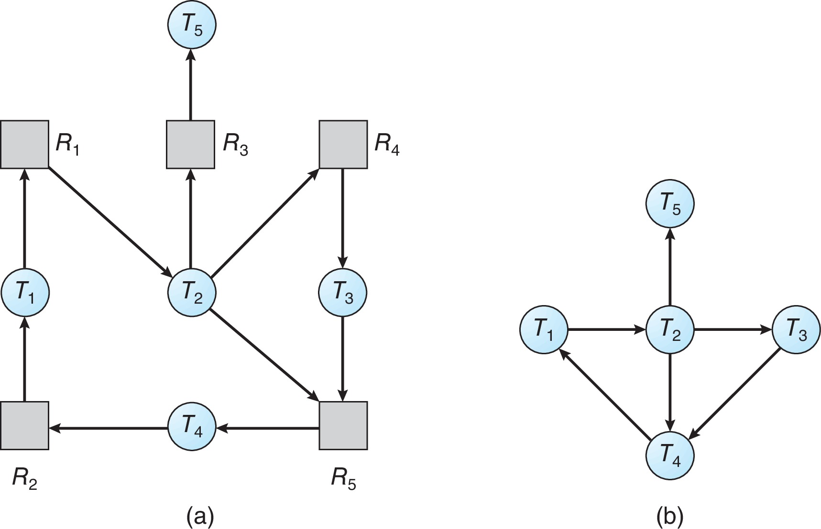
Resource-Allocation Graph and Wait-for Graph
Resource-Allocation Graph
Corresponding wait-for graph
Notes:
20

Slide 21
Deadlock Detection
Available
A vector of length m that indicates the number of instances of each resource type
Allocation
An n x m matrix that defines the number of resources of each type currently allocated to each thread
Request
An n x m matrix that indicates the current request of each thread
The detection algorithm investigates every possible allocation sequence for the threads that remain to be completed
1. Let Work and Finish be vectors of length m and n respectively
Initialize Work = Available

Slide 22
Deadlock Detection
For i= 0, 1, …, n-1,
if Allocation_{i} ≠ 0, then
Finish[i] = false
else Finish[i] = true
Find an index i such that both
Finish[i] == false
Request_{i} ≤ Work
If no such i exists, go to step 4
Work = Work + Allocation
Finish[i] = true
Go to step 2
If Finish[i] == false, for some i, 0 ≤ i < n then the system is in a deadlocked state
If Finish[i] == false, Ti is deadlocked
Illustration of the algorithm with an example

Slide 23
Example of Detection Algorithm
Allocation Request Available
A B C A B C A B C
T₀ 0 1 0 0 0 0 0 0 0
T₁ 2 0 0 2 0 2
T₂ 3 0 3 0 0 0
T₃ 2 1 1 1 0 0
T₄ 0 0 2 0 0 2
Sequence <T₀, T₂, T₃, T₁, T₄> will result in Finish[i] = true for all i
System is not deadlocked
Notes:
23

Slide 24
Example of Detection Algorithm
T₂ requests an additional instance of type C
Request
A B C
T₀ 0 0 0
T₁ 2 0 1
T₂ 0 0 1
T₃ 1 0 0
T₄ 0 0 2
Deadlock exists, consisting of processes T₁, T₂, T₃, and T₄
Notes:
24

Slide 25
Deadlock Detection
Detection Algorithm Usage
Two factors decide when to invoke detection algorithm
How often deadlock is likely to occur?
How many threads will be affected by it when it happens?
If deadlock occurs frequently, algorithm should be invoked frequently
One extreme
Algorithm is invoked every time a request for allocation cannot be granted immediately
Incurs a considerable overhead in computation time
Invoke at less frequent intervals
Invoke when the CPU utilization drops below a certain level

Slide 26
Recovery From Deadlock
Options to be followed when the detection algorithm detects a deadlock
Abort one or more threads to break the circular wait
Preempt some resources from one or more of the deadlocked threads
Process and Thread Termination
One of two methods is used
Abort all deadlocked processes
An expensive method
Abort one process at a time until the deadlock cycle is eliminated
This method incurs a considerable overhead
Aborting a process may leave certain resources in an inconsistent state

Slide 27
Recovery From Deadlock
For partial termination, selection of the process is required
This is a policy decision
Terminate those processes that incur minimum cost
Factors that may affect choice of a process
What is the priority of the process?
How long the process has computed?
How many and what types of resources the process has used?
How many more resources the process needs to complete?
How many processes will need to be terminated?
Whether the process is interactive or batch?

Slide 28
Recovery From Deadlock
Resource Preemption
Successively preempt some resources from processes and give these to other processes until the deadlock cycle is broken
Three issues need to be addressed
Selecting a victim
Which resources and which processes are to be preempted?
Minimize cost while preempting processes
Cost factors include
Number of resources a deadlocked process is holding
Amount of time the process has completed its execution

Slide 29
Recovery From Deadlock
Rollback
What should be done with the process which has its resources preempted?
Rollback the process to some safe state and restart from there
Simplest solution is total rollback:
Abort the process
Starvation
How can we guarantee that resources will not always be preempted from the same process?
Cost factor may select the same process every time deadlock is to be broken
A process should be selected to abort only for a finite number of times
Include the number of rollbacks in the cost factor

